Slide 1
A Review of 2WW skin pathway referrals in the month of September
Lawrence Abel 3rd Year MBBS

Slide 2
Background
Half of the million dermatology referrals to secondary care per year in England are 2ww:
6% of all these referrals end up with diagnosed SCC or BCC
More urgent (2ww) referrals than any other specialty;
A review of the pathway in 2021 emphasised the need for an expansion of referral services, including the use of teledermatology. ¹
Notes:
Half a million 2ww skin cancer referrals per year;
13 million GP consultations for skin issues per year around 15% ; yet historically very poorly taught in medical school and in training despite 38% go into GP training after foundation according to GP online

Slide 3
Melanoma checklist ²
If score of 3 or more then refer under 2ww
Notes:
Melanoma criteria are very broad and will cover many benign skin lesions; only way to differentiate is with closer inspection and dermoscopy photographs

Slide 4
SCC and BCC guidelines ²
Squamous cell carcinoma
1.7.4 Consider a suspected cancer pathway referral (for an appointment within 2 weeks) for people with a skin lesion that raises the suspicion of squamous cell carcinoma. [2015]
Basal cell carcinoma
1.7.5 Consider routine referral for people if they have a skin lesion that raises the suspicion of a basal cell carcinoma. (Typical features of basal cell carcinoma include: an ulcer with a raised rolled edge; prominent fine blood vessels around a lesion; or a nodule on the skin [particularly pearly or waxy nodules].) [2015]
1.7.6 Only consider a suspected cancer pathway referral (for an appointment within 2 weeks) for people with a skin lesion that raises the suspicion of a basal cell carcinoma if there is particular concern that a delay may have a significant impact, because of factors such as lesion site or size. [2015]
Notes:
Suspected SCC features might include:
Rough, reddish scaly patch
Open sore (often with a raised border)
Brown spot that looks like an age spot
Firm, dome-shaped growth
Wart-like growth
Tiny, rhinoceros-shaped horn growing from your skin
Sore developing in an old scar
NB. Does not include bowens (scaly plaque) → BAD recommends can be managed in primary care
BCC’s should be referred to either a GPSI if in a low risk location under normal non-urgent referral pathway → not into the 2ww pathway
If in high risk location e.g. face, esp. eye/eyelids, ear, nose (triangle of danger), or if very large/abnormal morphology suspecting morphoeic BCC
Morphoeic BCC
Usually found in mid-facial sites
Waxy, scar-like plaque with indistinct borders
Wide and deep subclinical extension
May infiltrate cutaneous nerves (perineural spread)
Also known as morpheic, morphoeiform or sclerosing BCC

Slide 5
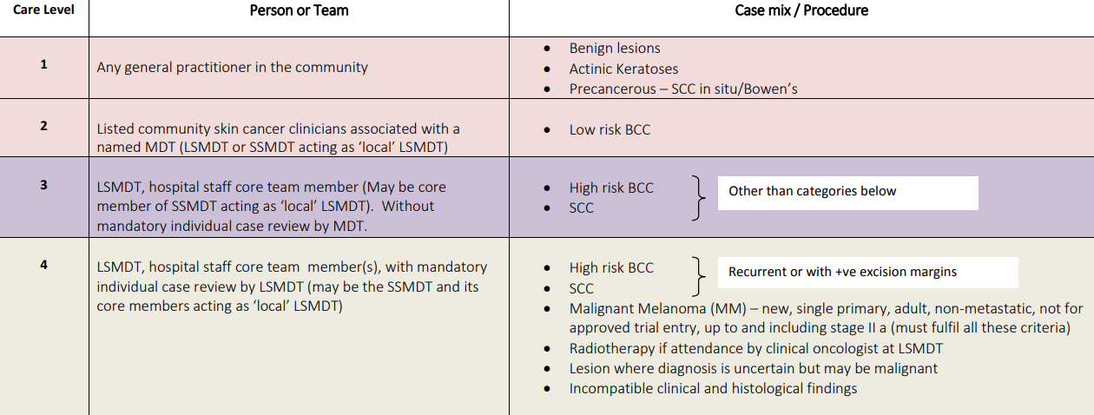
BAD Guidance on Care Levels (2014)
Image taken from BAD Skin Cancer Levels of Care (2014)
Notes:
As benign lesions can be managed in GP the aim is to be able to consistently and accurately identify these lesions; difficult in 10 minute consultation and without proper tools (dermatoscope)
Actinic keratoses can be frozen or use efudix (5 fluorouracil) /aldara (imiquimod)
Variety if benign lesions

Slide 6
Data Collection
1st to 31st of September 2022:
34 patients, for which 33 had data
- 15 melanoma referrals
- 13 SCC referrals
6 referred without box ticked
(for some of these had other diagnoses queried)
Notes:
For the Audit I took all the 2ww skin cancer referrals between 1st September and 31st September
Fairly equal in number of Melanoma and SCC referrals
For 6 without box ticked; suggested diagnoses included pyogenic granuloma, ulcer, and several where a query of melanoma or SCC was made in the referral indication but no box had been checked (presumed to be clerical error)
Interestingly where no box had been ticked and another diagnosis had been suspected these were more often the eventual diagnosis than not

Slide 7
Diagnoses by Secondary Care
4 BCC
1 SCC
No melanoma
Variety of seb k, benign naevi, haemangiomas, actinic keratoses and warts
Of 34 referred; 13 fully excised (38%), 4 punch biopsies (12%), 3 curetted (9%)
SBGW291
Notes:
While lower than the national average for 2ww melanoma and SCC rates; small study size and time of year may have contributed to this;
September people returning from holiday where moles may have been pointed out/more sun aware

Slide 8
Missed Lesions
In two cases lesions other than those with which the patient had been referred were picked up and excised;
SCC on ear
BCC on face
Emphasises importance of performing a skin check; particularly over high risk areas which have had lots of sun exposure.
Notes:
In several cases the lesion which the patient had been referred in with was benign but there had been other lesions; most commonly facial lesions which had been spotted in secondary care and excised.
If high levels of AK, demonstrates prolonged sun exposure over lifetime
or multiple changing moles in an elderly individual may point to a later presenting melanoma
Recognise constraints that the consultation length imposes 10 minutes; not time to get elderly/frail patients undressed to have a good look, also may not feel comfortable
Especially when lesion is mentioned at the end of another consultation as an add-on

Slide 9
Outcomes
In a majority of cases lesion which were referred were excised or biopsied in secondary care (58%)
In cases where lesions were discharged without intervention the most common diagnosis was Seborrheic Keratosis; these are difficult to distinguish from hx and examination without a dermatoscope.
Increased availability and use of dermatoscopes is needed to increase diagnosis of common benign skin lesions in primary care
Teledermatology may help in the triaging of lesions sent to secondary care and help reduce burden of appointments on already stretched secondary care services
Notes:
Most of lesions that were referred and not excised were seborrheic keratoses which can look very similar to melanoma and may be difficult to differentiate without magnification
Teledermatology services may be useful in triaging patients with many modern day phone cameras able to capture lesions in good detail; of course without dermoscopy images difficult to differentiate; requires good lighting and a second person to take the image in most cases
It would be interesting to see how referral rates when phone images are used; although potential to miss other lesions the patient has not spotted on their own

Slide 10
Dermatology Resources
Dermnet NZ
Primary Care Dermatology Society
Various pharmaceutical company sponsored teaching sessions

Slide 11
References
The two-week wait skin cancer pathway: innovative approaches to support early diagnosis of skin cancer as part of the NHS COVID-19 recovery plan. NHS England, British Association of Dermatologists. https://www.england.nhs.uk
Nice (2021) Skin Cancers – recognition and referral (NICE guidelines) National Institute for Heath and Care Excellence. http://www.nice.org

